Slide 1
Amino Acids, Polypeptides and Proteins TextBook: HARPERS REVIEW OF BIOCHEMISTRY

Slide 2
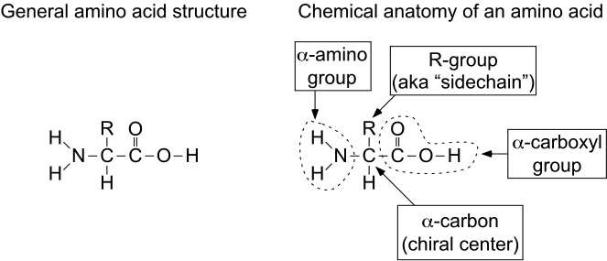
Anatomy of an amino acid

Slide 3
α-Amino acids
A. Example
(glycine) 2-aminoethanic acid
(aspartic acid) 2-aminobutane-1,4-dioic acid
(alanine) 2-aminopropanoic acid
(lysine) 2,6-diaminohexanoic acid

Slide 4
PROTONIC EQUILIBRIA OF AMINO ACIDS
Amino acid with equal number of amino and carboxyl group is neutral when dissolved in water, but in acidic solution, -COO⁻ group is protonated (I.e. exists as a –COOH), and basic solution, -NH₃⁺ group is free and exists as an –NH₂.
Therefore, the acidic group in amino acid is –NH₃⁺ NOT –COOH. The basic group in amino acid is -COO⁻ not –NH₂.

Slide 5
Isoelectric point and electrophoresis
By adjusting the pH value of the aqueous solution of an amino acid, the concentration of cation can be made equal to that of anion, and there will be no net migration of the amino acid in an electric field. The pH value so adjusted in this case is known as the isoelectric point of the given amino acid. Isoelectric points are characteristic of amino acids. Therefore it is possible to separate different amino acids in a mixture by subjecting the mixture to an electric field and adjusting the pH value, This technique is known as electrophoresis.

Slide 6
Groups of Amino Acids
1. Polar, uncharged amino acids
Contain R-groups that can form hydrogen bonds with water
Includes amino acids with alcohols in R-groups (Ser, Thr, Tyr)
Amide groups: Asn and Gln
Usually more soluble in water
Exception is Tyr (most insoluble at 0.453 g/L at 25 °C)
Sulfhydryl group: Cys
Cys can form a disulfide bond (2 cysteines can make one cystine)

Slide 7
Uncharged polar side chains
COO⁻
COO⁻
COO⁻
+
+
+
H₃N
C
H
H₃N
C
H
H₃N
C
H
CH₂
H
C
OH
CH₂
COO⁻
+
OH
CH₃
H₃N
C
H
Serine
Ser
S
Threonine
Thr
T
H
OH
Glycine
Gly
G
Tyrosine
Tyr
Y
Notes:
Polar Aas are imortant since they provide chemical groups for interaction with water. Thus, the hydrogen bonding character of polar Amino acids is key in forming structures. Whie the ionic bonding character of charged polar Aas is also important for protein structures. They also provide chemically reactive groups in proteins.
Serine has a OH group that does not normally ionize so it is not charged in proteins (it is neutral). It is the smallest of the polar amino acids and very polar. The hydroxyl group on Ser provides enzymes a very giooid nucleophilic group for doing chemistry., It is also important to form esters with phosphate making phosphester proteins. Phosphyorylation of proteins and enzymes is very important in regulation of activity.
Thr adds a carbon on to Ser, which makes the hydroxyl group less accessible than in Ser. Thr is more oftten in a structural role in proteins and is not as chemically active as Ser. Thr can form esters with phosphoric acid and phospho-Threionine is often found in proteins.
Tyr is a hydrophobic aromatic alcohol but has some polar character. The hydroxyl of Tyr is like the hydroxyl group on phenol, so if the pH is high (basic) it can ionize. Tyr can also form phosphoesters like Ser and Thr. It is important in proteins and in enzymes for regulation of the cell cycle.

Slide 8
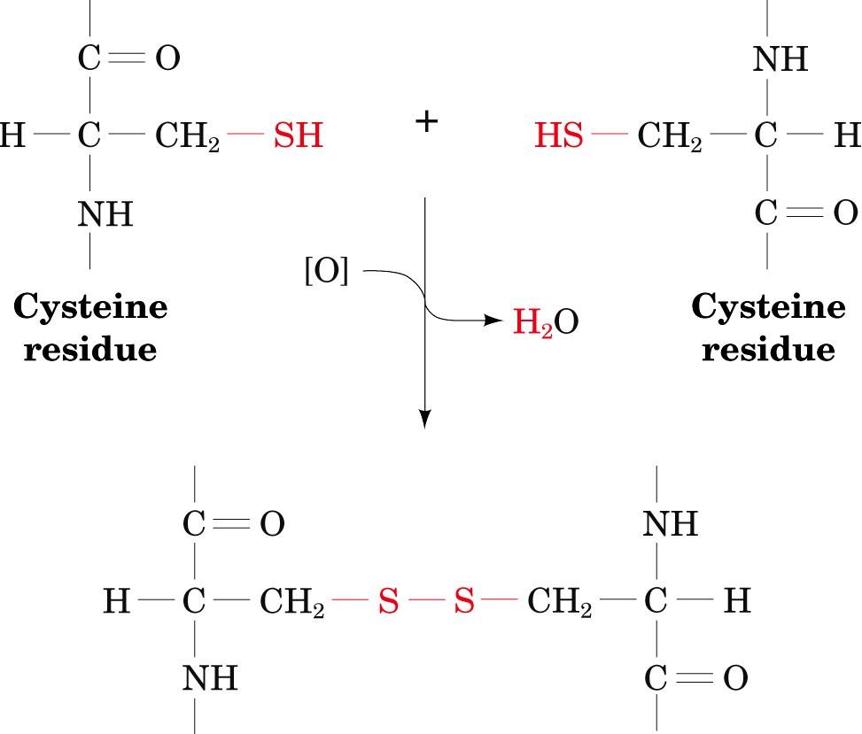
Formation of cystine
Notes:
The formation of Cystine can take place between 2 polypeptide chains to make a cross link between them. Extracellular proteins often contain Cys-Cys bonds, while cellular proteins rarely have them in the m since the environment in the cell is reducing. In the presence of oxygen or oxidizing conditions, the 2 thils react to form a disulfide bond between them. Since this is a redox reaction, the hydride ion released by each thil is usually coupled to an electonacceptor reaction or in simple oxidation with oxygen, hydrogen peroxide is usually formed with further reduction to water.

Slide 9
Groups of Amino Acids
2. Acidic amino acids
Amino acids in which R-group contains a carboxyl group
Asp and Glu
Have a net negative charge at pH 7 (negatively charged pH > 3)
Negative charges play important roles
Metal-binding sites
Carboxyl groups may act as nucleophiles in enzymatic interactions
Electrostatic bonding interactions

Slide 10
Charged polar (acidic) side chains
COO⁻
COO⁻
+
+
H₃N
C
H
H₃N
C
H
CH₂
CH₂
CH₂
C
O
O⁻
C
O
O⁻
Aspartic acid
Asp
D
Glutamic acid
Glu
E

Slide 11
Groups of Amino Acids
3. Basic amino acids (Charged polar (basic) side chains)
Amino acids in which R-group have net positive charges at pH 7
His, Lys, and Arg
Lys and Arg are fully protonated at pH 7
Participate in electrostatic interactions
His has a side chain pK_{a} of 6.0 and is only 10% protonated at pH 7
Because His has a pK_{a} near neutral, it plays important roles as a proton donor or acceptor in many enzymes.
His containing peptides are important biological buffers

Slide 12
Charged polar (basic) side chains
COO⁻
COO⁻
+
+
COO⁻
C
H₃N
C
H
H₃N
H
+
H₃N
C
H
CH₂
CH₂
CH₂
CH₂
CH₂
CH₂
CH₂
HC
C
CH₂
NH
H⁺N
NH
C
NH₃⁺
CH
NH₂⁺
NH₂
Lysine
Lys
K
Histidine
His
H
Arginine
Arg
R
Notes:
LYSINE has a protonated alky amino group
Argining has a guanidinium
Histidine has an imidazolium ionized group

Slide 13
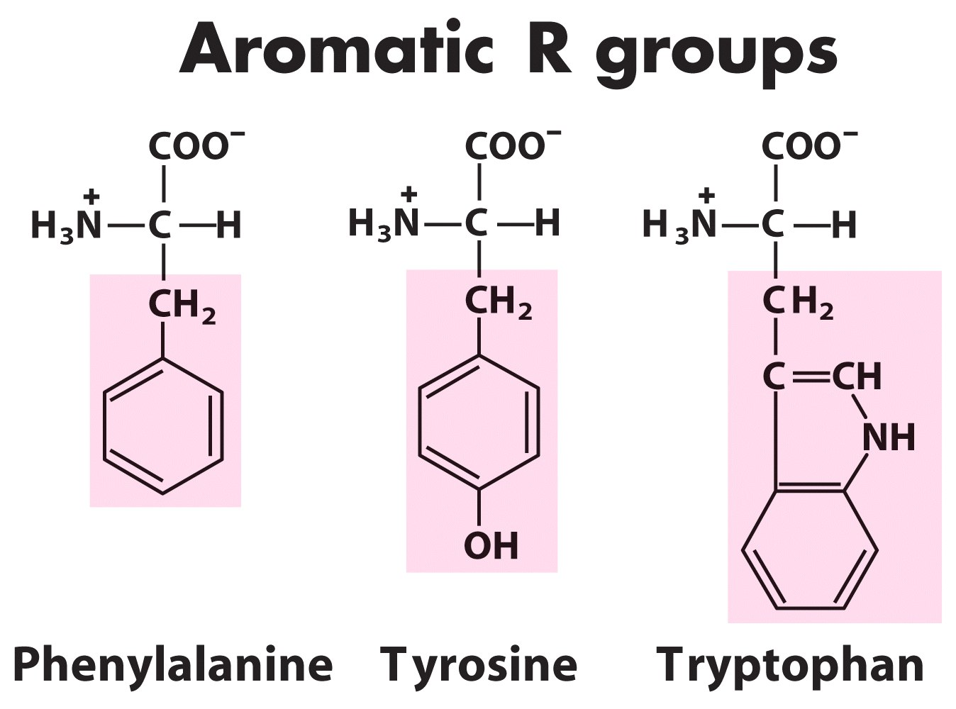
4. Aromatic R group

Slide 14
Nonstandard amino acids
20 common amino acids programmed by genetic code
Nature often needs more variation
Nonstandard amino acids play a variety of roles: structural, antibiotics, signals, hormones, neurotransmitters, intermediates in metabolic cycles, etc.
Nonstandard amino acids are usually the result of modification of a standard amino acid after a polypeptide has been synthesized.
If you see the structure, could you tell where these nonstandard amino acids were derived from?

Slide 15
Nonstandard amino acids
Notes:
These are amino acids derivatives found in proteins
4-hydroxyproline and 5-hydroxylysine are structural components of collagen a structural protein
N-formyl methionine is the N-terminal residue of all prokaryotic proteins but is usually removed as the protein matures
Gamma-carbocyglutamate is part of proteins involved in blood clotting
Methylated and acetylated amino acids are important parts of ribosomal proteins and chromosomal proteins called histones (important for chromatin formation in eukaryotes)

Slide 16
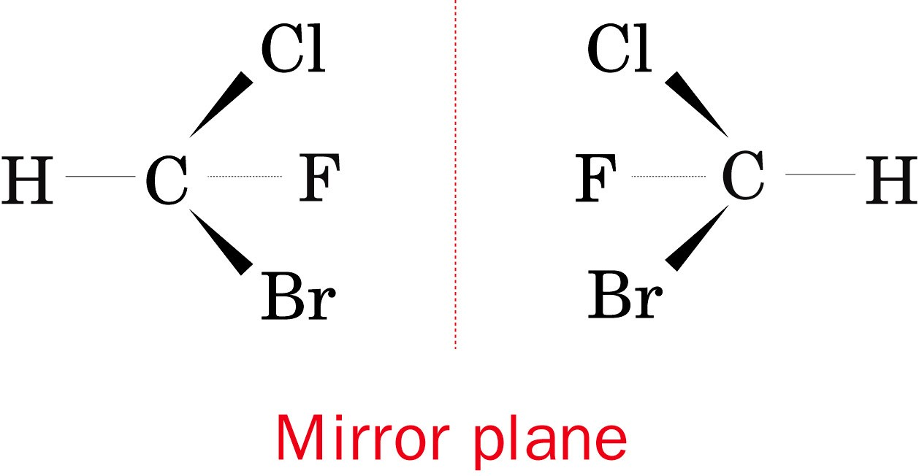
Characteristics of Amino acids 1- Amino acids are optically active
All amino acids are optically active (exception Gly).
Optically active molecules have asymmetry; not superimposable (mirror images)
Central atoms are chiral centers or asymmetric centers.
Enantiomers -molecules that are nonsuperimposable mirror images
Notes:
Enantiomers of fluorochlorobormomethane

Slide 17
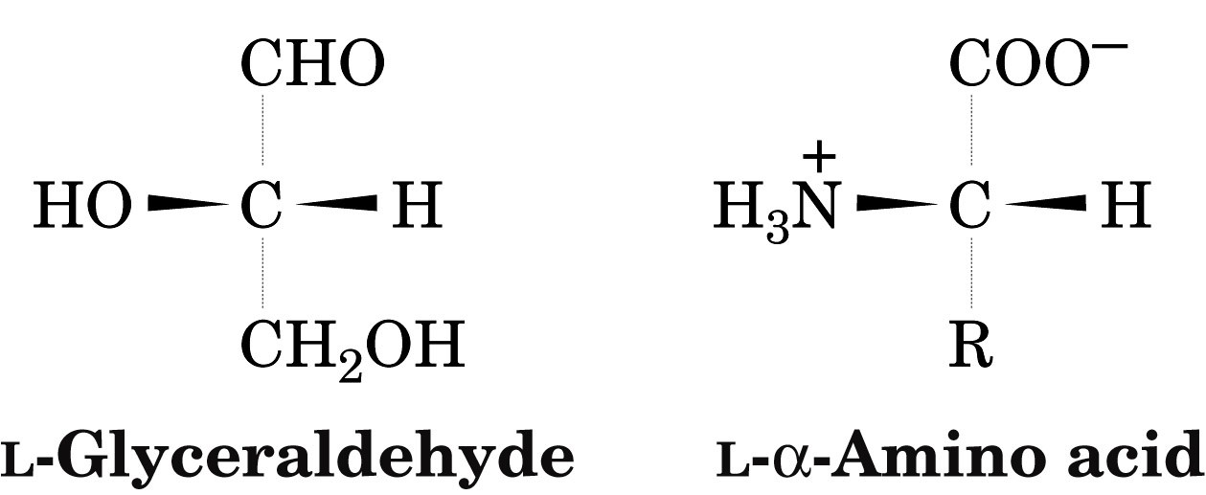
Asymmetry
For α-amino acids the arrangement of the amino, carboxyl, R, and H groups about the C_{α} atom is related to glyceraldehyde
Notes:
Thus L glyceraldehyde and L-alpha amino acids are said to have the same relative configurations.

Slide 18
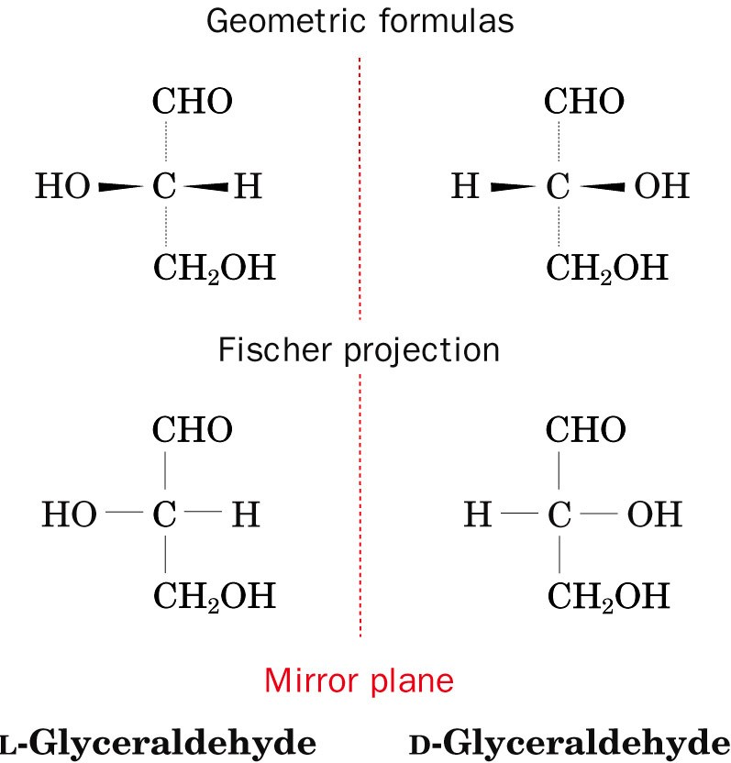
Asymmetry
Notes:
In Fisxher projections all horizontal bonds point above the page and all vertical bonds below the page.

Slide 19
2. Diastereomers
Stereoisomers or optical isomers are molecules with different configurations about at least one of their chiral centers but are otherwise identical
Since each asymmetric center in a chiral molecule can have two possible configurations, a molecule with n chiral centers has 2^{n} different possible stereoisomers and 2^{n-1} enantiomeric pairs
Ex. Threonine and Isoleucine both have two chiral centers, and thus 4 possible stereoisomers.

Slide 20
Diastereomers
*
*
Notes:
The mirror images on the top of this figure are the L and D forms.
The two other optical isomers are the Diastereomers or allo forms of the L and D forms.
The D-allo and L-allo forms are mirror images of one another just like the D and L forms
Neither allo form is symmetrically related to either of the D or L forms
Diastereomers are physically and chemically distinct. We see differences in melting points, spectra, and chemical reactivity. VERY Different from one another.

Slide 21
Amino Acids Are Joined By Peptide Bonds In Peptides
- α-carboxyl of one amino acid is joined to α-amino of a second amino acid (with removal of water)
- only α-carboxyl and α-amino groups are used, not R-group carboxyl or amino groups

Slide 22
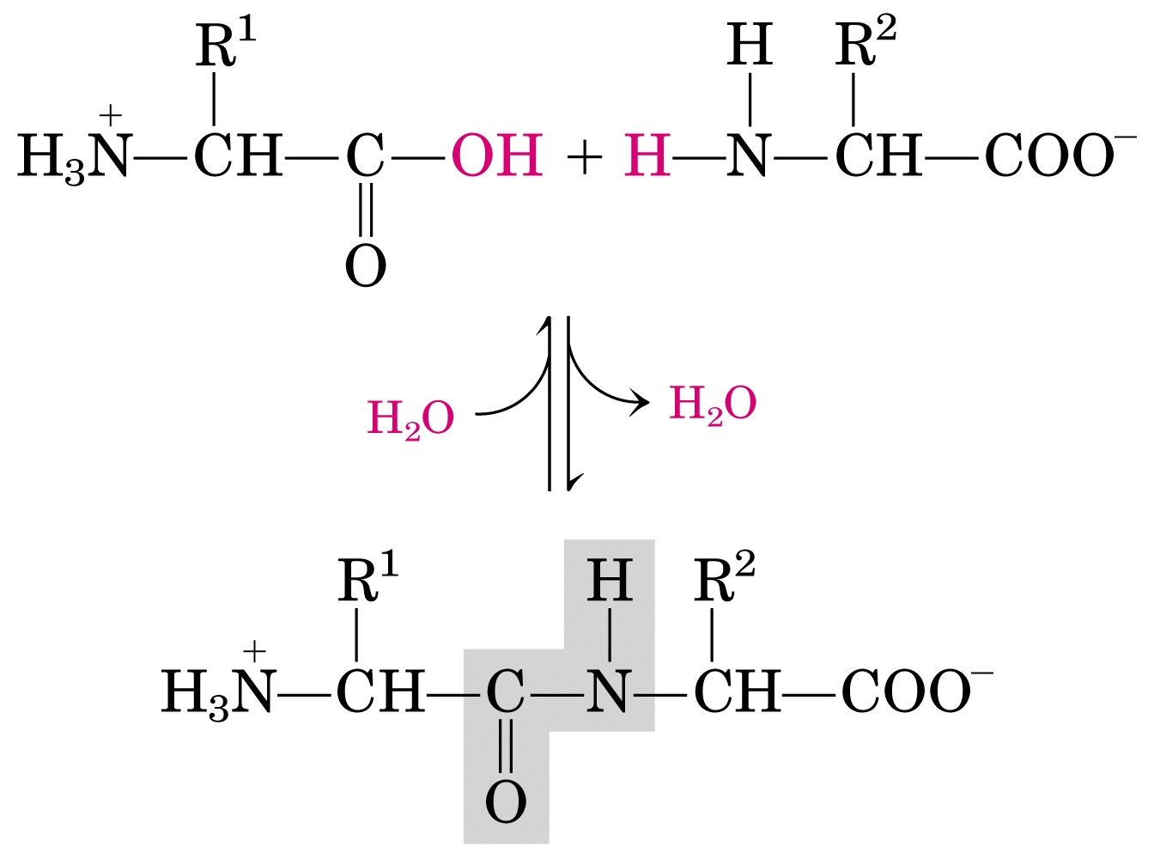
Chemistry of peptide bond formation

Slide 23
Making dipeptides
⁺H₃N-CHR-CO₂⁻ + ⁺H₃N-CHR-CO₂⁻ →
⁺H₃N-CHR-CONH-CHR-CO₂⁻ + H₂O
This process can be repeated to make a tripeptide and so on:
⁺H₃N-CHR-CONH-CHR-CO₂⁻ + ⁺H₃N-CHR-CO₂⁻ → ⁺H₃N-CHR-CONH-CHR-CONH-CHR-CO₂⁻

Slide 24
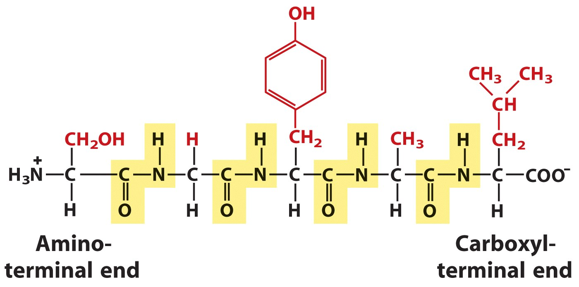

Slide 25
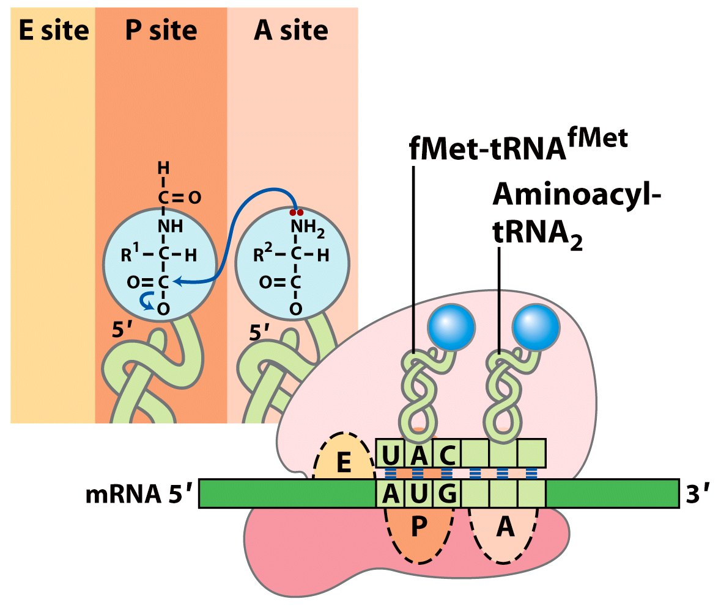

Slide 26
Hydrolysis of polypeptides & amino acid analysis
Polypeptides can be hydrolyzed to constituent amino acids.
This is typically done by boiling the polypeptide in 6 M HCl for 24 hours.
⁺H₃N-CHR-CONH-CHR-CONH-CHR-CO₂⁻ + 2 H₂O → 3 ⁺H₃N-CHR-CO₂⁻

Slide 27
Disulfide bonds
2 cysteine → cystine
2 R-SH → R-S-S-R (Note: This is an oxidation)
Intracellular conditions are maintained sufficiently reducing to inhibit formation of most disulfide bonds.
Extracellular conditions (as well as those found in some organelles) are more oxidizing, favoring disulfide formation.
Thus, extracellular proteins containing cysteines often have disulfides, while intracellular (cytosolic) proteins rarely have disulfides.

Slide 28
Reactions with amino acids:
I. Amino group
Acylation → R-(C=O)-NH-R’
Ninhydrin reaction Causes oxidative decarboxylation of α-amino acids, and release of ammonia, which reacts with a second molecule of ninhydrin to form a purple product. (You don’t need to know details – just know that it reacts with any free amino group and the final product is purple.)

Slide 29
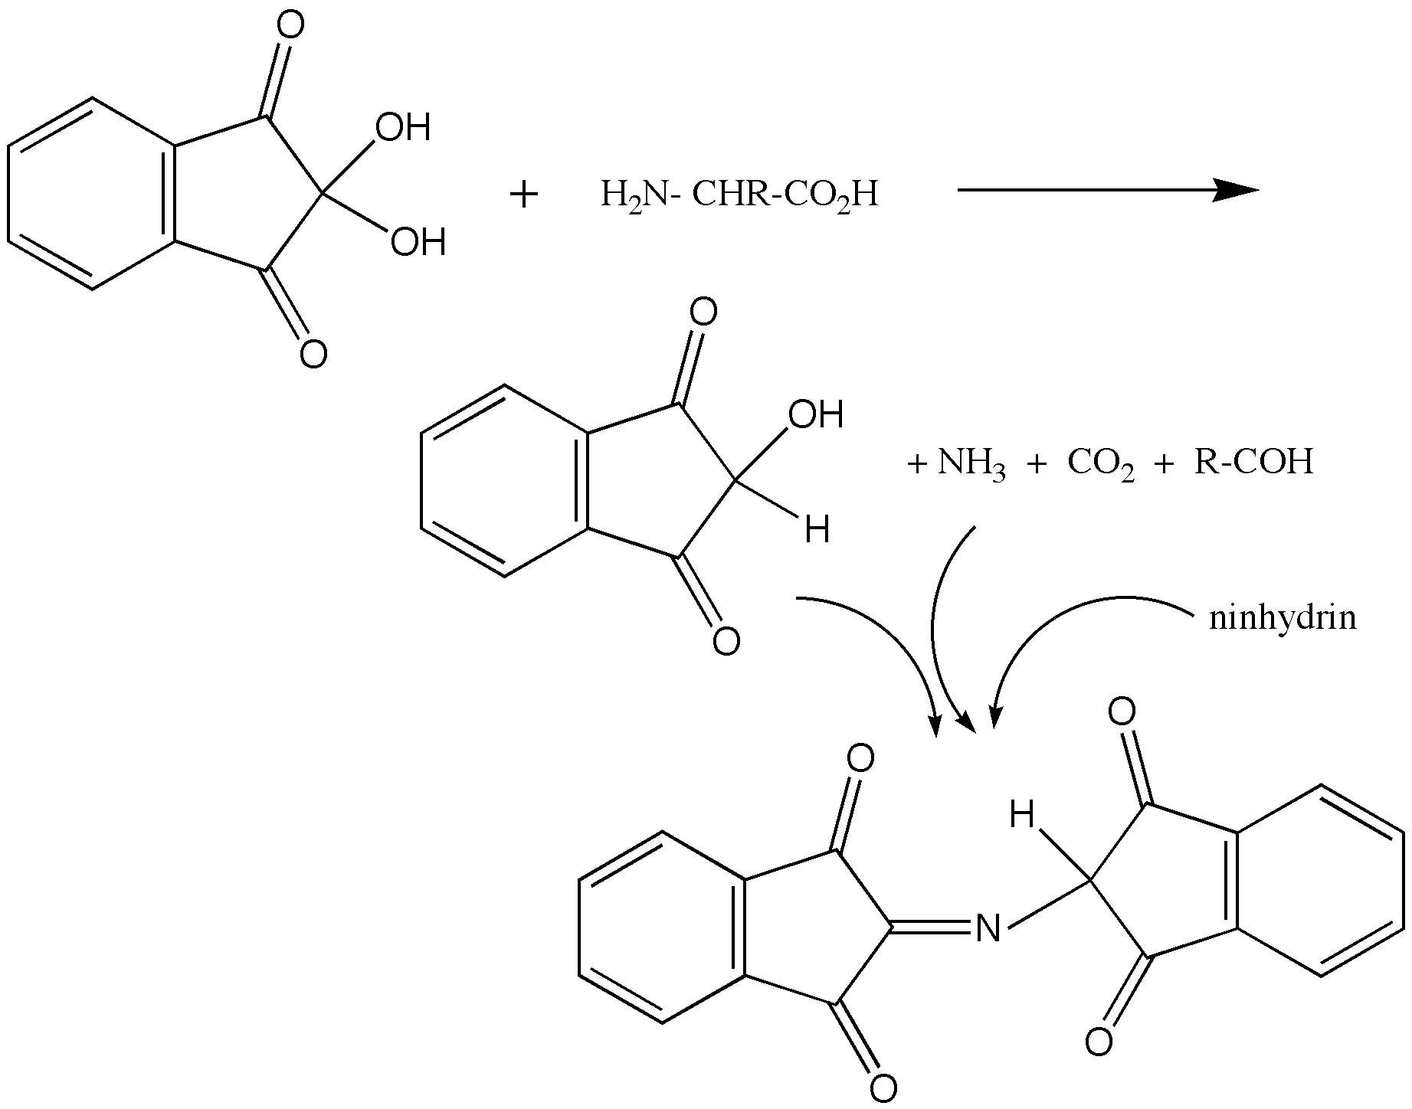
Reactions with amino acids:
I. Amino group
Ninhydrin reaction

Slide 30
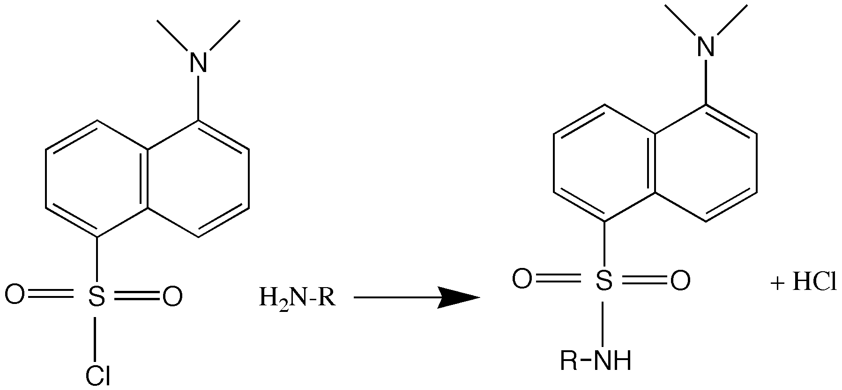
Reactions with amino acids:
Fluorodinitrobenzene reaction
Dansyl chloride reaction

Slide 31
Reactions with amino acids:
Carboxyl group
Amide formation
Ester formation
Acyl halide formation
Reduction to alcohol (via aldehyde)

